Slide 1
Let’s Play Search&Destroy!
Gary R Maixner III
User Experience Librarian and Liaison to Communication Studies
Notes:
https://upload.wikimedia.org/wikipedia/commons/b/be/Tennis_in_France%2C_16th_century.jpg
https://uwaterloo.ca/centre-for-teaching-excellence/teaching-resources/teaching-tips/tips-students/self-directed-learning/self-directed-learning-four-step-process
Mari:
Active learning
Self-directed learning
We’re tired of lecturing and running workshops on these concepts, let’s give ourselves a break.
Students are tired of lessons on these concepts (but need them anyway), let’s make them fun.

Slide 2
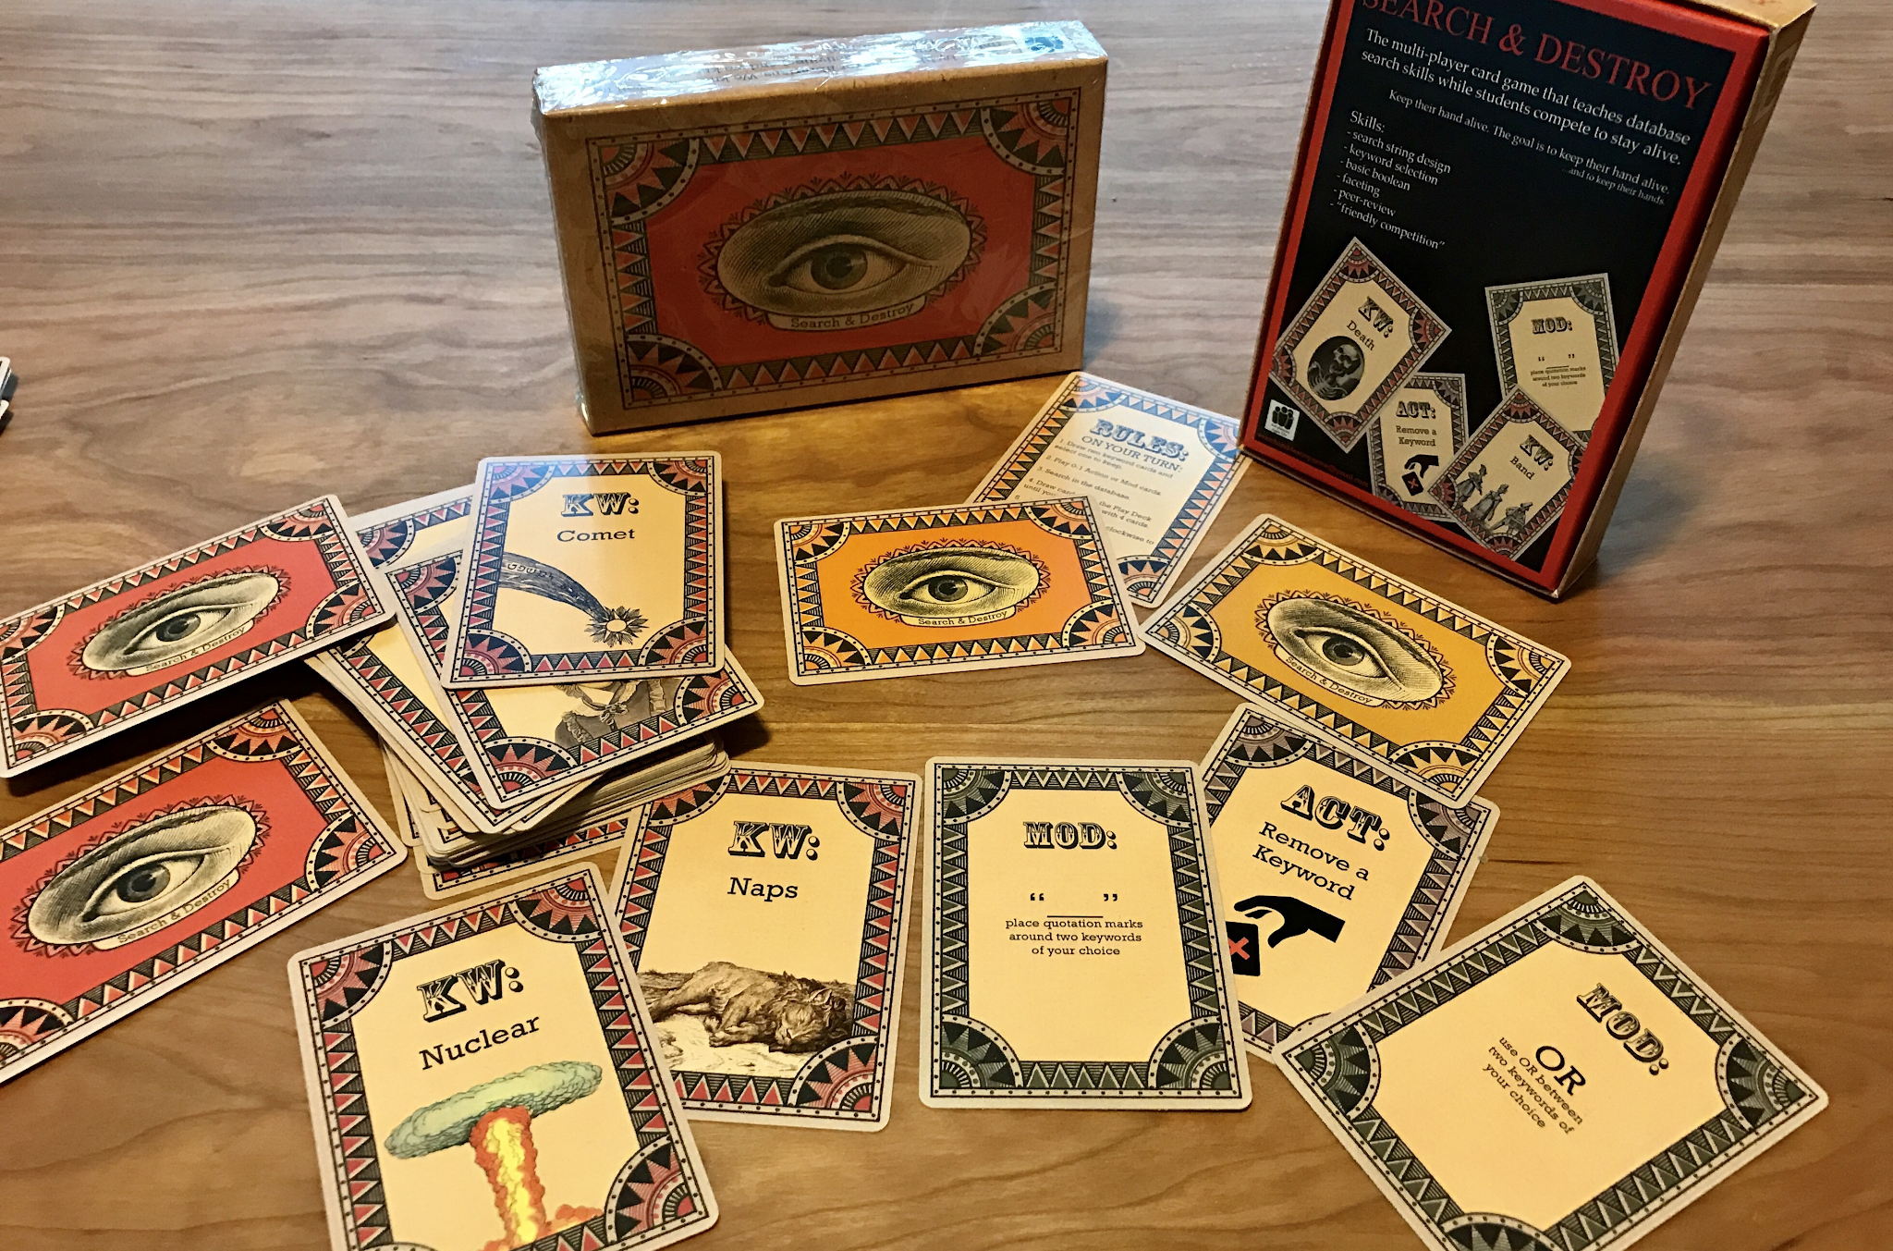
Notes:
https://upload.wikimedia.org/wikipedia/commons/b/be/Tennis_in_France%2C_16th_century.jpg
https://uwaterloo.ca/centre-for-teaching-excellence/teaching-resources/teaching-tips/tips-students/self-directed-learning/self-directed-learning-four-step-process
Mari:
Active learning
Self-directed learning
We’re tired of lecturing and running workshops on these concepts, let’s give ourselves a break.
Students are tired of lessons on these concepts (but need them anyway), let’s make them fun.

Slide 3
PUT A SCREENSHOT AND LINK TO LIBRARY WEBSITE ON THIS SLIDE
Notes:
https://upload.wikimedia.org/wikipedia/commons/b/be/Tennis_in_France%2C_16th_century.jpg
https://uwaterloo.ca/centre-for-teaching-excellence/teaching-resources/teaching-tips/tips-students/self-directed-learning/self-directed-learning-four-step-process
Mari:
Active learning
Self-directed learning
We’re tired of lecturing and running workshops on these concepts, let’s give ourselves a break.
Students are tired of lessons on these concepts (but need them anyway), let’s make them fun.

Slide 4
How to Play
Draw two Keyword Cards (red deck) and select one to keep
Place the one you keep in front of you where everyone can see and discard the other
Play 0-1 Action or Mod (yellow deck) cards
You cannot on your first turn
Search in the database using all of the Keywords and Mods that you have
If you have results, you’re still in the game!
Draw back up to 4 cards from the Play Deck (Action and Mod Cards)
Game passes to next player
Notes:
https://upload.wikimedia.org/wikipedia/commons/b/be/Tennis_in_France%2C_16th_century.jpg
https://uwaterloo.ca/centre-for-teaching-excellence/teaching-resources/teaching-tips/tips-students/self-directed-learning/self-directed-learning-four-step-process
Mari:
Active learning
Self-directed learning
We’re tired of lecturing and running workshops on these concepts, let’s give ourselves a break.
Students are tired of lessons on these concepts (but need them anyway), let’s make them fun.

Slide 5
Draw 2 KW Cards, keep 1
Notes:
https://upload.wikimedia.org/wikipedia/commons/b/be/Tennis_in_France%2C_16th_century.jpg
https://uwaterloo.ca/centre-for-teaching-excellence/teaching-resources/teaching-tips/tips-students/self-directed-learning/self-directed-learning-four-step-process
Mari:
Active learning
Self-directed learning
We’re tired of lecturing and running workshops on these concepts, let’s give ourselves a break.
Students are tired of lessons on these concepts (but need them anyway), let’s make them fun.

Slide 6
Draw 2 KW Cards, keep 1
Notes:
https://upload.wikimedia.org/wikipedia/commons/b/be/Tennis_in_France%2C_16th_century.jpg
https://uwaterloo.ca/centre-for-teaching-excellence/teaching-resources/teaching-tips/tips-students/self-directed-learning/self-directed-learning-four-step-process
Mari:
Active learning
Self-directed learning
We’re tired of lecturing and running workshops on these concepts, let’s give ourselves a break.
Students are tired of lessons on these concepts (but need them anyway), let’s make them fun.

Slide 7
Play 0-1 Action and Mod Cards
Notes:
https://upload.wikimedia.org/wikipedia/commons/b/be/Tennis_in_France%2C_16th_century.jpg
https://uwaterloo.ca/centre-for-teaching-excellence/teaching-resources/teaching-tips/tips-students/self-directed-learning/self-directed-learning-four-step-process
Mari:
Active learning
Self-directed learning
We’re tired of lecturing and running workshops on these concepts, let’s give ourselves a break.
Students are tired of lessons on these concepts (but need them anyway), let’s make them fun.

Slide 8
3. Search in the database
REPLACE WITH YOU OWN SCREENSHOT!
Notes:
https://upload.wikimedia.org/wikipedia/commons/b/be/Tennis_in_France%2C_16th_century.jpg
https://uwaterloo.ca/centre-for-teaching-excellence/teaching-resources/teaching-tips/tips-students/self-directed-learning/self-directed-learning-four-step-process
Mari:
Active learning
Self-directed learning
We’re tired of lecturing and running workshops on these concepts, let’s give ourselves a break.
Students are tired of lessons on these concepts (but need them anyway), let’s make them fun.

Slide 9
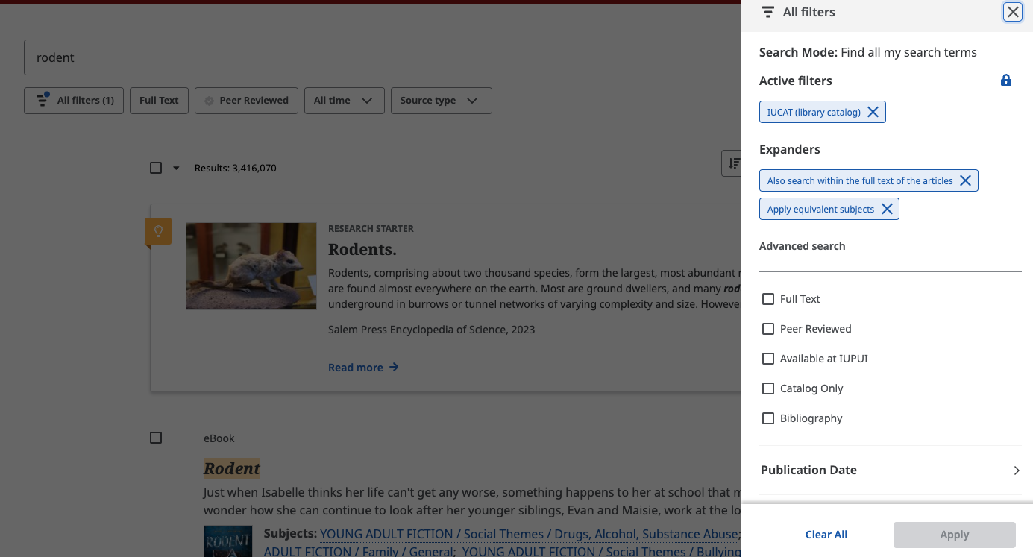
3. Search in the database (apply filters)
REPLACE WITH YOU OWN SCREENSHOT!
Notes:
https://upload.wikimedia.org/wikipedia/commons/b/be/Tennis_in_France%2C_16th_century.jpg
https://uwaterloo.ca/centre-for-teaching-excellence/teaching-resources/teaching-tips/tips-students/self-directed-learning/self-directed-learning-four-step-process
Mari:
Active learning
Self-directed learning
We’re tired of lecturing and running workshops on these concepts, let’s give ourselves a break.
Students are tired of lessons on these concepts (but need them anyway), let’s make them fun.

Slide 10
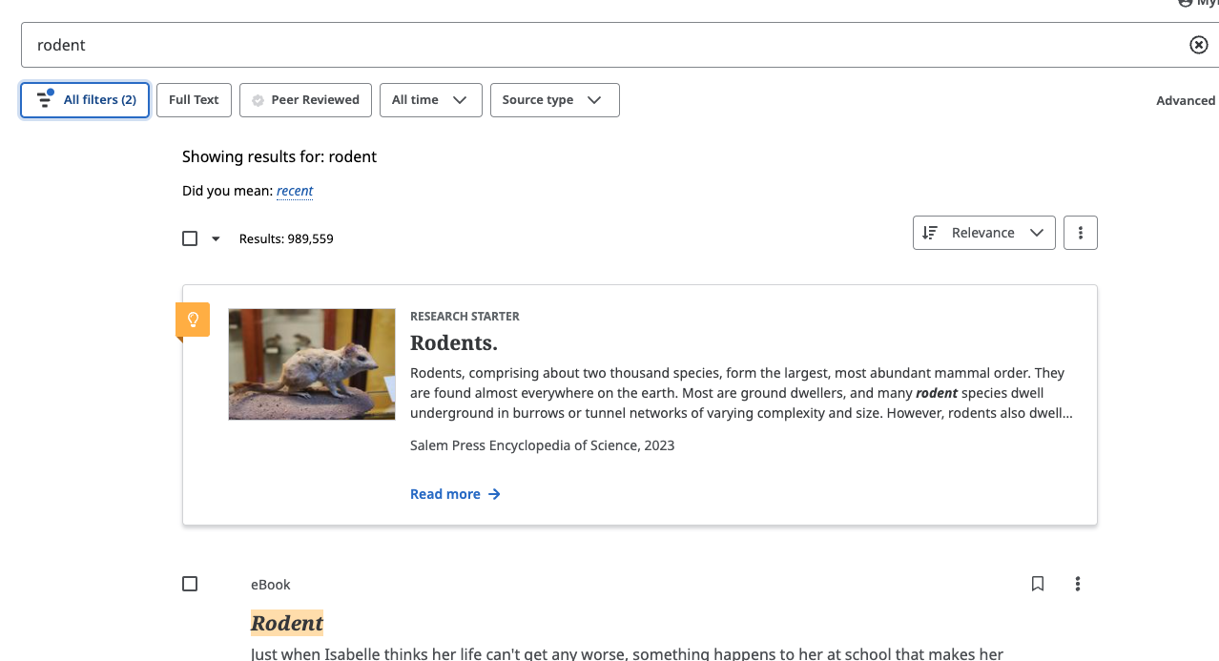
3. Search in the database
REPLACE WITH YOU OWN SCREENSHOT!
Notes:
https://upload.wikimedia.org/wikipedia/commons/b/be/Tennis_in_France%2C_16th_century.jpg
https://uwaterloo.ca/centre-for-teaching-excellence/teaching-resources/teaching-tips/tips-students/self-directed-learning/self-directed-learning-four-step-process
Mari:
Active learning
Self-directed learning
We’re tired of lecturing and running workshops on these concepts, let’s give ourselves a break.
Students are tired of lessons on these concepts (but need them anyway), let’s make them fun.

Slide 11
4. Draw Action and Mod Cards until I have 4
Notes:
https://upload.wikimedia.org/wikipedia/commons/b/be/Tennis_in_France%2C_16th_century.jpg
https://uwaterloo.ca/centre-for-teaching-excellence/teaching-resources/teaching-tips/tips-students/self-directed-learning/self-directed-learning-four-step-process
Mari:
Active learning
Self-directed learning
We’re tired of lecturing and running workshops on these concepts, let’s give ourselves a break.
Students are tired of lessons on these concepts (but need them anyway), let’s make them fun.

Slide 12
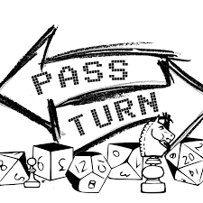
5. Pass turn!
Notes:
https://upload.wikimedia.org/wikipedia/commons/b/be/Tennis_in_France%2C_16th_century.jpg
https://uwaterloo.ca/centre-for-teaching-excellence/teaching-resources/teaching-tips/tips-students/self-directed-learning/self-directed-learning-four-step-process
Mari:
Active learning
Self-directed learning
We’re tired of lecturing and running workshops on these concepts, let’s give ourselves a break.
Students are tired of lessons on these concepts (but need them anyway), let’s make them fun.

Slide 13
Quick Clarifications
Notes:
https://upload.wikimedia.org/wikipedia/commons/b/be/Tennis_in_France%2C_16th_century.jpg
https://uwaterloo.ca/centre-for-teaching-excellence/teaching-resources/teaching-tips/tips-students/self-directed-learning/self-directed-learning-four-step-process
Mari:
Active learning
Self-directed learning
We’re tired of lecturing and running workshops on these concepts, let’s give ourselves a break.
Students are tired of lessons on these concepts (but need them anyway), let’s make them fun.

