Slide 1
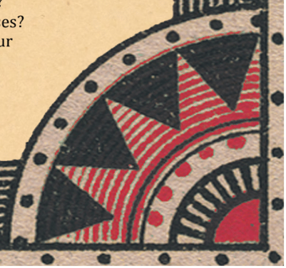
Search for Evidence EBP in Nursing Practice
Presenter Name

Slide 2
Today’s Goals:
Meet your librarians
Build literature
searching skills

Slide 3
We will:
Create a research question
Search strategically
Access the library
Find the best information
Get full-text literature

Slide 4
Evidence
Based
Practice

Slide 5
The use of environmental clues and intuition to make clinical decisions
What is Evidence Based Practice?
The conscientious, explicit, and judicious use of current best evidence in making decisions about the care of individual patients.
The application of scientific data to clinical practice regardless of professional experience or patient wants.

Slide 6
EBP needs all three!
Best Research Evidence
Clinical Expertise
Patient Values

Slide 7
What don’t we know?
Research
Discovery
an unanswered question or unfilled need for information
Scientific Research
EBP
What do we know?
Evidence-Based Practice
Translation
takes a clinical, educational or administrative question, and discovers what research exists to answer the question
QI
Quality Improvement
What can we do better?
Optimization
changes the current process or procedures to improve patient outcomes and ensure better adherence to existing best practices

Slide 8
Ask
Search
Appraise
Apply
Evaluate
EBP
Process

Slide 9
Ask
Search
Appraise
Apply
Evaluate
Ask a
question

Slide 10
PICO helps us ask a focused and specific clinical question.
P | I | C | O
Patient/ Problem | Intervention | Comparison | Outcomes

Slide 11
You have an elderly diabetic patient with stage III foot ulcers.
Currently your hospital uses standard moist wound therapy to treat stage III foot ulcers.
You have heard negative pressure wound therapy can improve wound healing.
P | I | C | O
Patient/Problem | Intervention | Comparison | Outcomes
Elderly diabetic patient with stage III foot ulcers
Negative pressure wound therapy
Standard moist wound therapy
Improved wound healing

Slide 12
P | I | C | O
Patient/Problem | Intervention | Comparison | Outcomes
Elderly diabetic patient with stage III foot ulcers | Negative pressure wound therapy | Standard moist wound therapy | Improved wound healing
Based on the key elements you have identified, What is the PICO Question?
In elderly diabetic patients with stage III foot ulcers, what is the effect of negative pressure wound therapy compared to standard moist wound therapy on wound healing?

Slide 13
Sources of information

Slide 14
Before we can search we need to know what to look for !
How many study types can you name?

Slide 15
systematic reviews
meta-analysis
qualitative surveys
randomized control
trials
Case studies
expert opinion

Slide 16
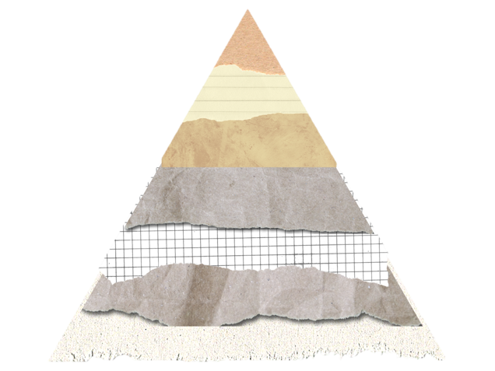
Meta Analysis
Clinical
Guidelines
Systematic Reviews
Randomized Control Trials
Cohort Studies
Case Control Studies
Case Reports/Case Series
Background Literature/
Expert Authored Opinion

Slide 17
Filtered Information
Unfiltered Information

Slide 18
What is a Systematic Review?
The systematic part:
A team of researchers search for all the studies done on a particular research question
They review them for validity, reliability and bias using a scientifically proven method
The review part:
The researchers discuss the studies that meet their pre-approved standards in order to provide you with a summary of the evidence

Slide 19
What is a Meta-Analysis?
It builds upon a (well-done) systematic review
When there are a good number of studies, all answering the same question, that are reliable, valid, and non-biased.
Researchers can combine results to answer the research question with a bigger population of people studied.
larger population = more reliable results
+

Slide 20
Study design can be reflected in:
The article title
Abstract (Methods and/or Design section
Journal Title

Slide 21
Clinical Practice Guidelines
Created by government agencies and professional organizations
Based on systematic reviews

Slide 22
Where to find the literature

Slide 23
Library Website

Slide 24
There are many databases

Slide 25
Cochrane Database of Systematic Reviews
The JBI Database of Systematic Reviews
available on

Slide 26
Clinical
Practice
Guidelines
Check your
site’s procedures

Slide 27
Ask
Search
Appraise
Apply
Evaluate
Searching

Slide 28
PICO can also help you identify keywords for your search
P | I | C | O
Patient/Problem | Intervention | Comparison | Outcomes
Elderly diabetic patient with stage III foot ulcers | Negative pressure wound therapy | Standard moist wound therapy | Improved wound healing
SYNONYMS
Aged Diabetic foot Foot ulcers DFUs Lesions | Negative pressure wound dressing NPWT Vacuum-assisted closure Topical negative pressure | Dressings Occlusive Bandages Moist wound advanced moist wound therapy | Wound healing Complications Infection Blood flow

Slide 29
Search skill
Using AND, OR, & NOT

Slide 30
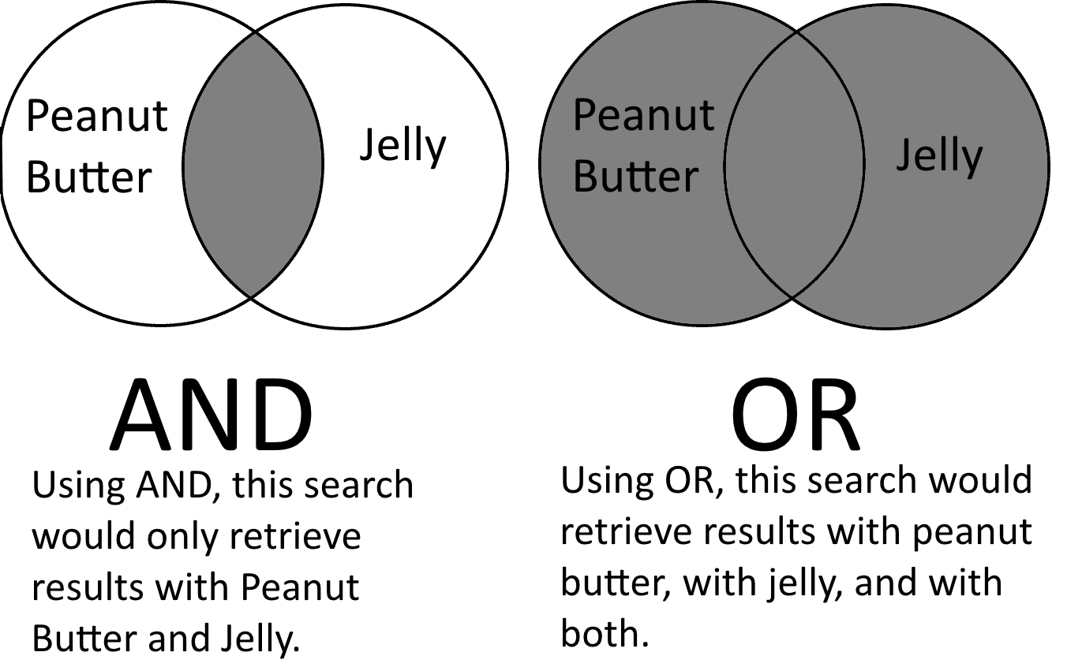
Connect terms to get the best results
Narrow Broad
Less Results
More Results
NOT
=
Less Results
Notes:
Databases are programmed to prioritize Boolean Operators. This is often called "search precedence" and it influences how your search is performed. For instance, most databases give AND precedence over OR, meaning terms linked with AND will be searched before those linked with OR, no matter the order they appear in your search. In any database, using parentheses will override the search precedence.

Slide 31
AND
AND
AND
P | I | C | O
Patient/Problem | Intervention | Comparison | Outcomes
Elderly diabetic patient with stage III foot ulcers | Negative pressure wound therapy | Standard moist wound therapy | Improved wound healing
SYNONYMS
Aged Diabetic foot Foot ulcers DFUs Lesions | Negative pressure wound dressing NPWT Vacuum-assisted closure Topical negative pressure | Dressings Occlusive Bandages Moist wound advanced moist wound therapy | Wound healing Complications Infection Blood flow
OR

Slide 32
(diabetic foot ulcers OR DFU)
AND (negative pressure wound therapy OR NPWT) AND (moist wound therapy OR moist dressings)

Slide 33
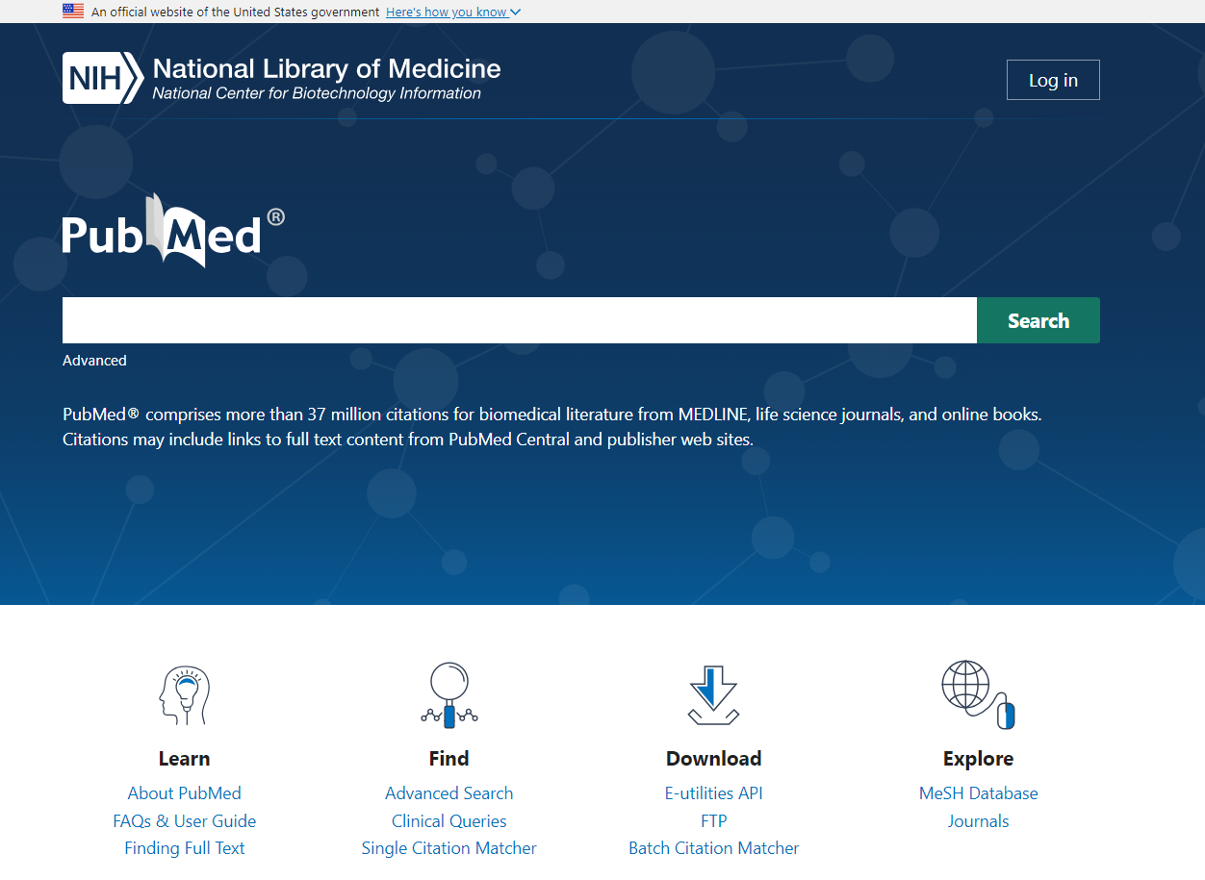
diabetic foot ulcers AND NPWT AND (moist wound therapy OR moist dressings)

Slide 34
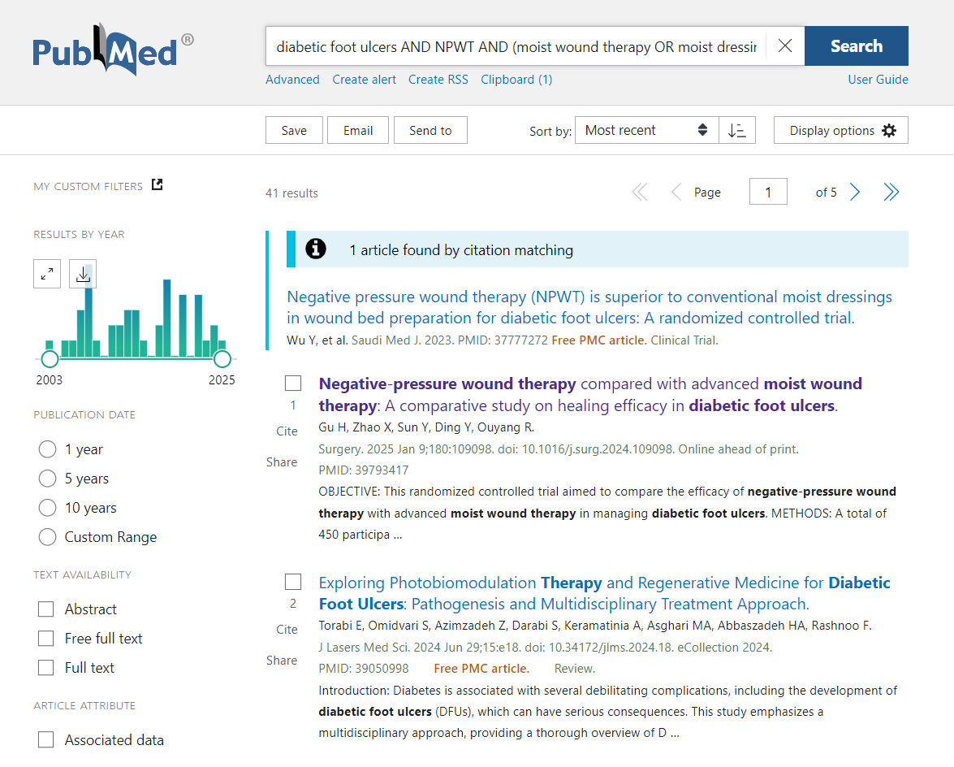
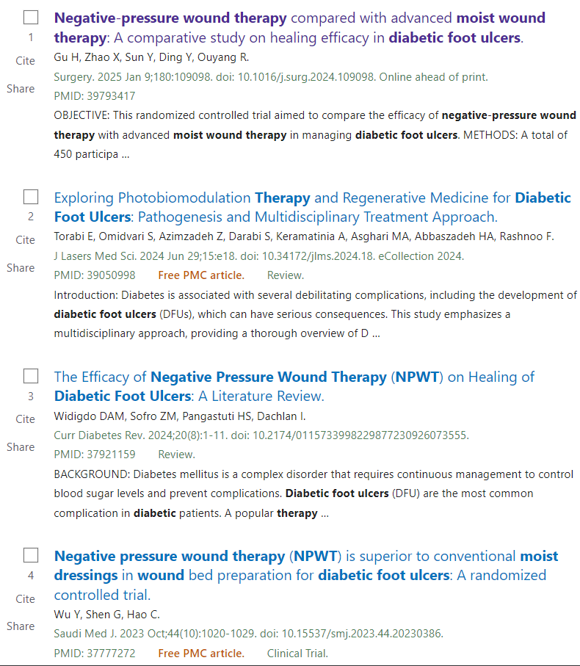
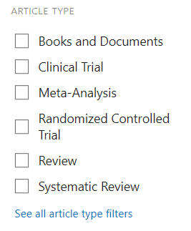

Slide 35
Search skill
Faceting by publication date, study type, language, human/animal studies, & age.

Slide 36
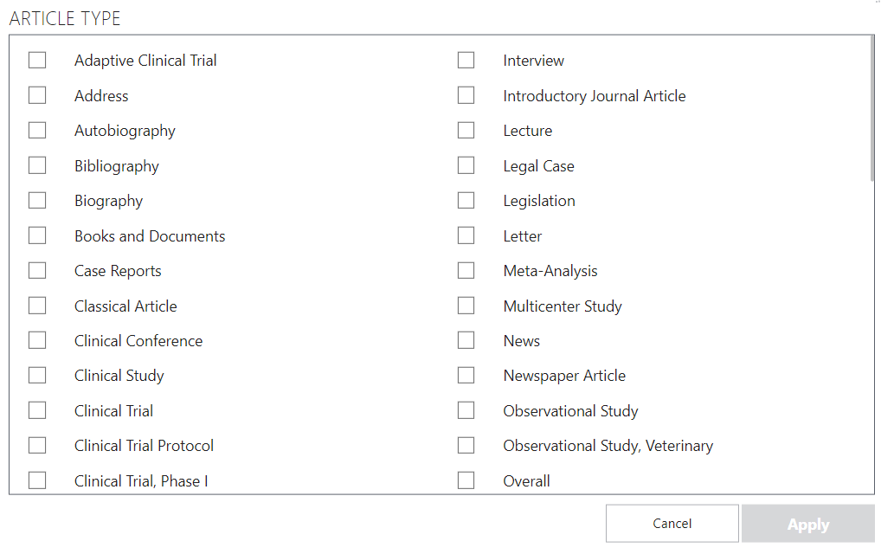
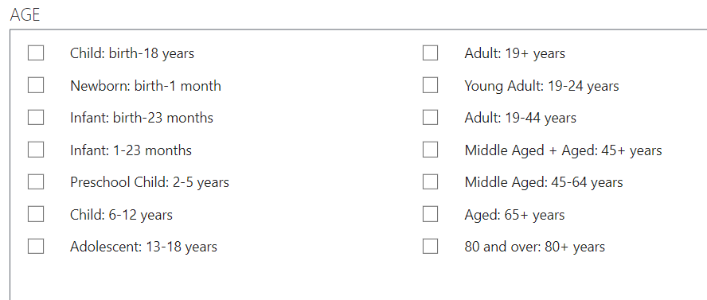
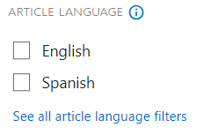
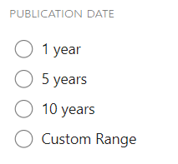
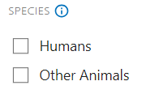
Filters to look out for
Notes:
Databases are programmed to prioritize Boolean Operators. This is often called "search precedence" and it influences how your search is performed. For instance, most databases give AND precedence over OR, meaning terms linked with AND will be searched before those linked with OR, no matter the order they appear in your search. In any database, using parentheses will override the search precedence.

Slide 37
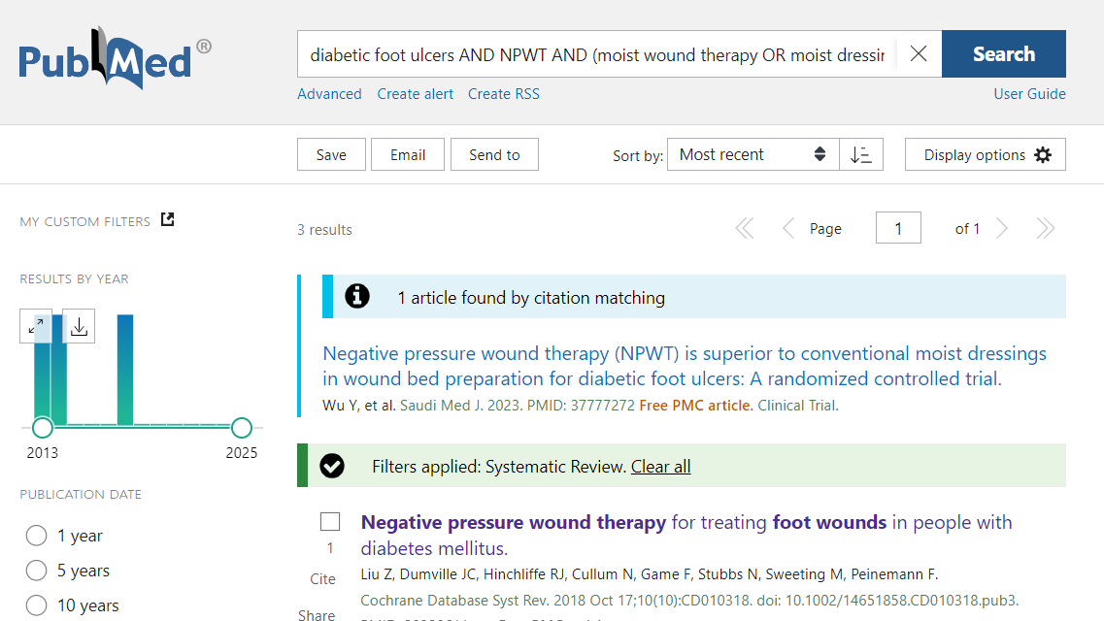
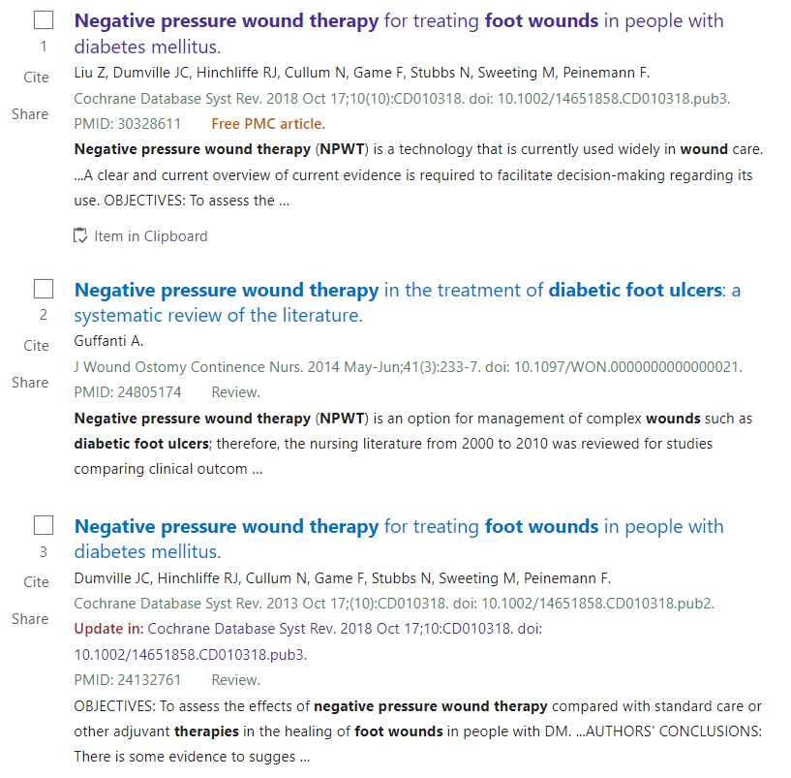
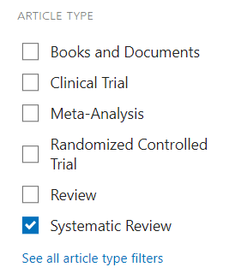
Less Results
Notes:
Databases are programmed to prioritize Boolean Operators. This is often called "search precedence" and it influences how your search is performed. For instance, most databases give AND precedence over OR, meaning terms linked with AND will be searched before those linked with OR, no matter the order they appear in your search. In any database, using parentheses will override the search precedence.

Slide 38
Search skill
Title field searching

Slide 39
diabetic foot ulcers[title] AND NPWT
AND (moist wound therapy OR moist dressings)

Slide 40
diabetic foot ulcers[title] AND NPWT AND (moist wound therapy OR moist dressings)

Slide 41
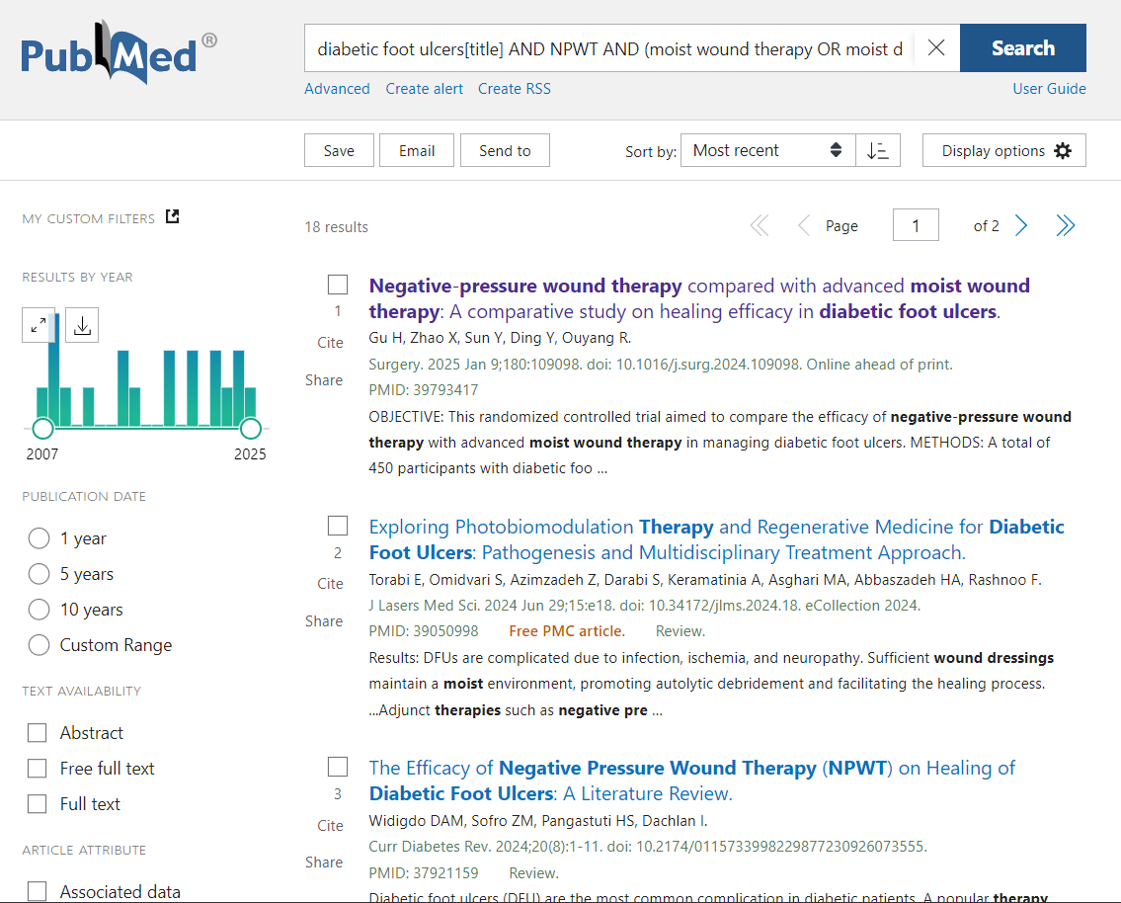
Less Results

Slide 42
Search skill
Quotation marks for phrase searching

Slide 43
“diabetic foot ulcers”
AND NPWT
AND (moist wound therapy OR moist dressings)

Slide 44
“diabetic foot ulcers” AND NPWT AND (moist wound therapy OR moist dressings)

Slide 45
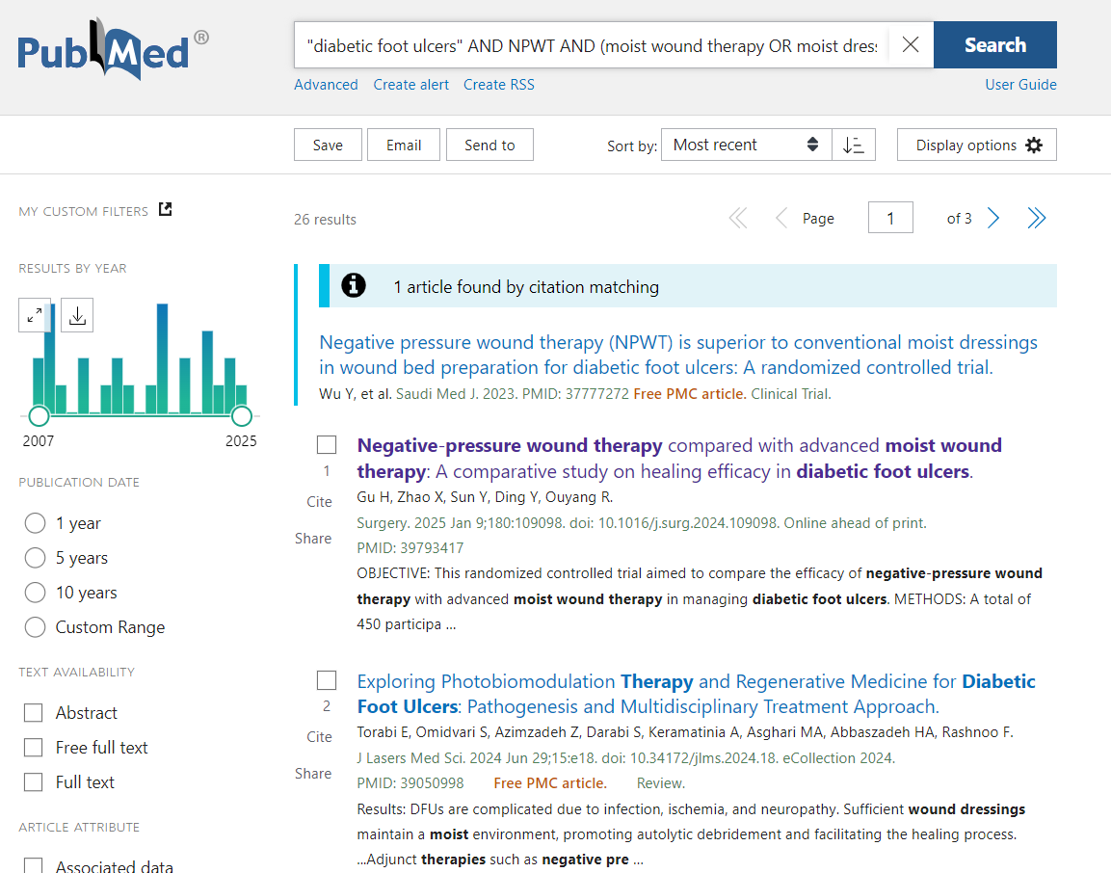
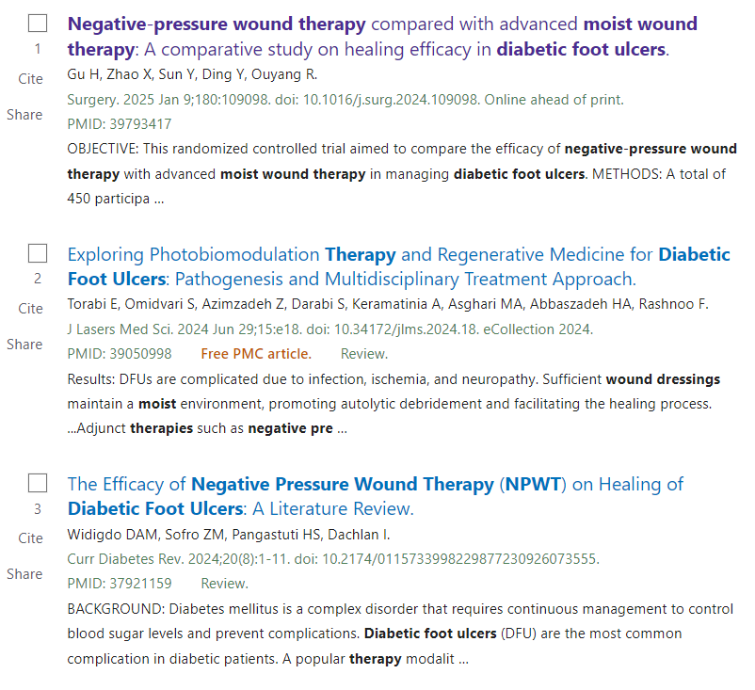
Less Results

Slide 46
Search skill
Truncation

Slide 47
diabet*
AND NPWT
AND (moist dressings OR moist wound therapy)

Slide 48
diabet* AND NPWT AND (moist dressings OR moist wound therapy)

Slide 49
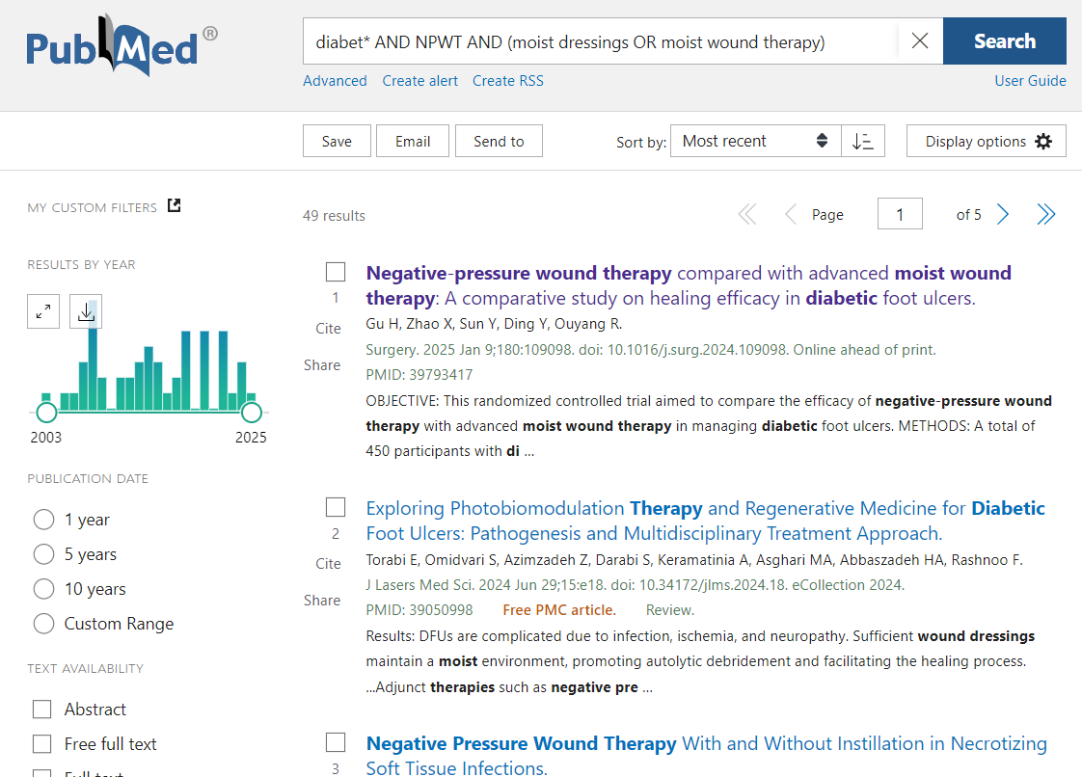
More Results

Slide 50
Ask
Search
Appraise
Apply
Evaluate
Appraise the results

Slide 51
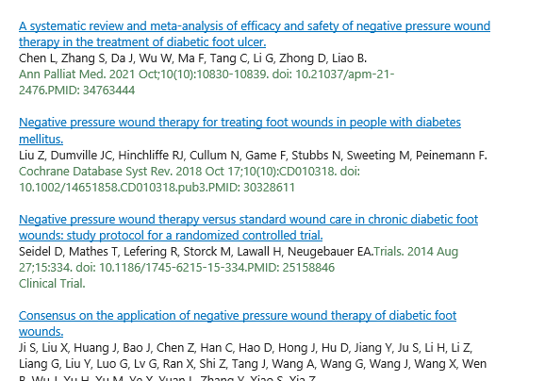
A good search gets many relevant results
Which of these studies has the best evidence?

Slide 52
Search & Destroy
The daredevil game of to-the-death database searching.

Slide 53
Today’s
Database:

Slide 54
Steps to access this database:

Slide 55
Two Decks
KW
Mod
Action
Keyword Deck Play Deck

Slide 56
Game Rules
On Your Turn
Draw two keyword cards and select one to keep.
Play 0-1 Action or Mod cards.
Search in the database.
Draw cards from the Play Deck until your hand is full with 4 cards.
Game moves counter-clockwise to the next player.

Slide 57
Round 1
Option to use a Play Deck card in your hand
OR give one to an opponent
Draw 4 Play Deck cards
KW
KW
Search in the database
Action
Mod
Draw 2 Keyword Deck cards and pick 1 to keep

Slide 58
Class
Evaluation

Slide 59
Thank You! Questions?
Slides by:
Regina Vitiello, M.L.S.
Librarian
Daniel Carroll Payson Medical Library
North Shore University Hospital
rvitiello1@northwell.edu

